Slide 1
Elasticity

Slide 2
Elasticity of Demand
Super important concept with a terrible name

Slide 3
Thought experiment
You are author that gets 10% of the gross sales of your book (number sold x price).
The publisher is increasing the price of your book from $15 to $20.
Are you happy?

Slide 4
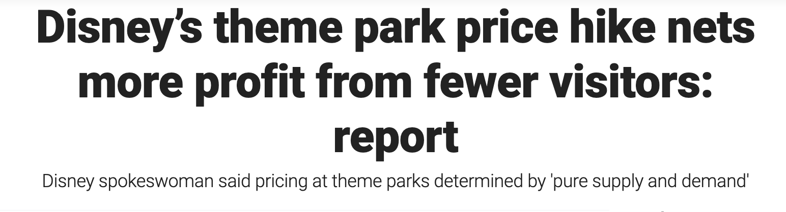

Slide 5
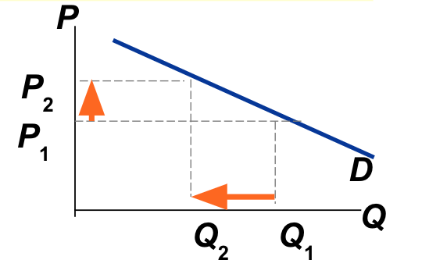
Remember, Demand Curves Slope Downward

Slide 6
Price Elasticity of Demand
Elasticity:
  A measure of the responsiveness of buyers and sellers to changes in price or income.
Why is it useful?
  When price changes, we can determine how much buyers and sellers change their behavior.
Notes:
Lecture tip:
Explain to students that:
elasticity = responsiveness.
Emphasize that elasticity can compare the responsiveness of the relationship between any two variables.
There are several types of elasticity that detail the sensitivity of the relationship between different pairs of variables.
Supply and demand allows us to predict what happens to quantity demanded or quantity supplied in terms of whether it falls or rises; elasticity allows us to be more precise and put a size to that change.
As stated in the “Previously” slide (slide #2):
A price change will cause us to slide along the demand curve to a different point on that same curve.
Other factors changing (income, preferences, price of other goods) will cause the demand curve to shift.
We’ve seen the direction of the slide or shift, but now (with elasticity) we will learn more about the size of these changes.

Slide 7
Price Elasticity of Demand
Price elasticity of demand:
  A measure of the responsiveness of quantity demanded to a change in price.
  This gives us the sensitivity of the relationship between these two variables.
Notes:
Lecture notes:
Recall the law of demand:
Demand curve is downward-sloping.
This gives us the direction of the relationship between these two variables.
Elasticity allows us to be more precise and put a size to that change in Q_{D}.
Underscore why this is important to know:
Businesses know if they raise prices, they will sell fewer units.
But how many fewer units? That is something they’d like to know.

Slide 8
Price Elasticity of Demand
Demand is elastic if
  quantity demanded changes significantly as the result of a price change.
  Elastic = “sensitive” or “responsive.”
Demand is inelastic if
  quantity demanded changes a small amount as the result of a price change.
  Inelastic = “insensitive” or “unresponsive.”
Notes:
Classroom demonstration: Elasticity as a Rubber Band
This demonstration can be found in the Interactive Instructor’s Guide (see Tip #139).
Use elastic bands to demonstrate responsiveness, but make sure you find some that are difficult to stretch and others that are easy to stretch.
An alternative to using rubber bands is to use a set of “bounce/no bounce” balls
One ball is bouncy, so as you drop it to the floor, it responds by bouncing back (elastic).
The other ball does not respond; when you drop it, it remains on the floor (inelastic).

Slide 9
Price Elasticity of Demand
Price elasticity of demand
Percentage change in Q^{d}
=
Percentage change in P
Price elasticity of demand measures how much Q^{d} responds to a change in P.
Loosely speaking, it measures the price-sensitivity of buyers’ demand.
Notes:
‹#›

Slide 10
Why Percents?
https://youtu.be/QlAg9rhNRuU?si=oOZfNQ3RLTbxgu8z

Slide 11
Price Elasticity of Demand
Price elasticity of demand
Percentage change in Q^{d}
=
Percentage change in P
P
Example:
P rises by 10%
Price elasticity
of demand equals
P₂
P₁
D
-15%
Q falls by 15%
Q
= -1.5
Q₂
Q₁
10%
Notes:
‹#›

Slide 12
What determines price elasticity?
Notes:
‹#›
In essence, the textbook says “Here are the determinants of elasticity. The first one is availability of close substitutes. Here’s an example….”
That’s great for a textbook. For teaching, I’ve found a different approach to be far more effective: having students deduce the general lessons from specific examples they can figure out using common sense. This is the approach on the next few slides.
Also, see notes on the next slide for a good suggestion.

Slide 13
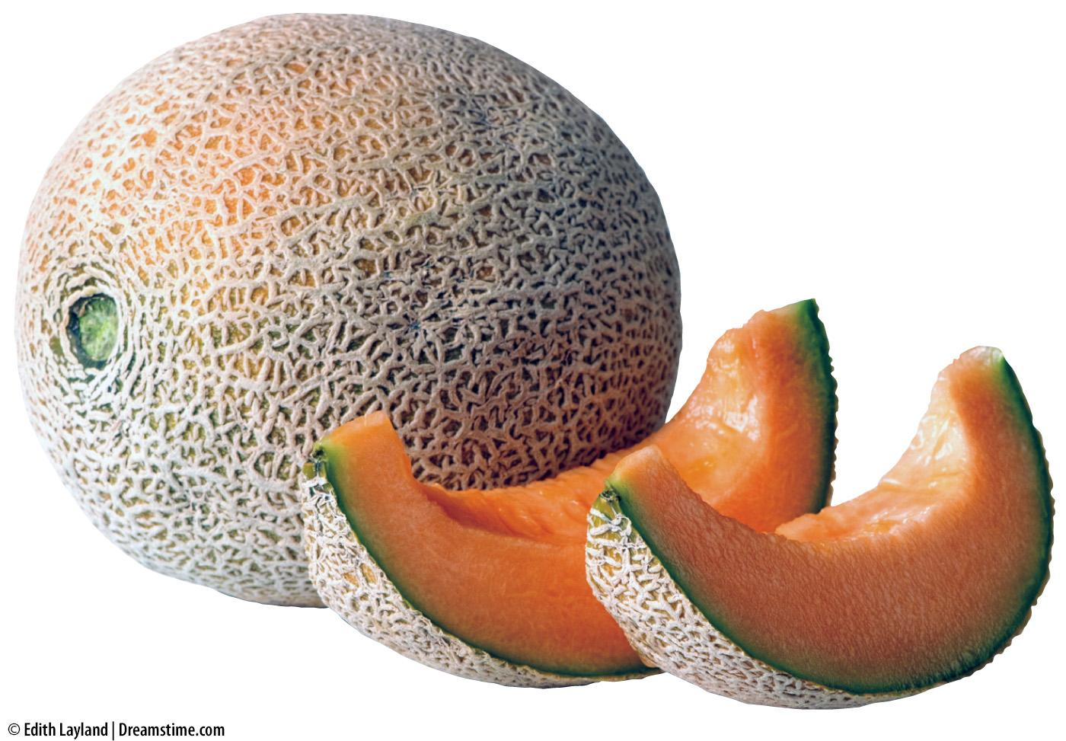

Determinants of the Price Elasticity of Demand—1
Existence of substitutes: Determines the options consumers have when the price changes.
  Many substitutes -> elastic demand
  Few substitutes -> inelastic demand
Notes:
Lecture tip:
Ask students to provide some examples of determinants.
Some possible examples include:
Goods with many substitutes:
toiletries (toothpaste, deodorant, shampoo, etc.)
breakfast cereals
fruits and vegetables
fast food
Goods with few substitutes:
clean drinking water
electricity
gasoline
medical goods such as insulin
[fruit: © Edith Layland | Dreamstime.com; lightbulb: © Rick Rhay/iStockphoto.com]

Slide 14
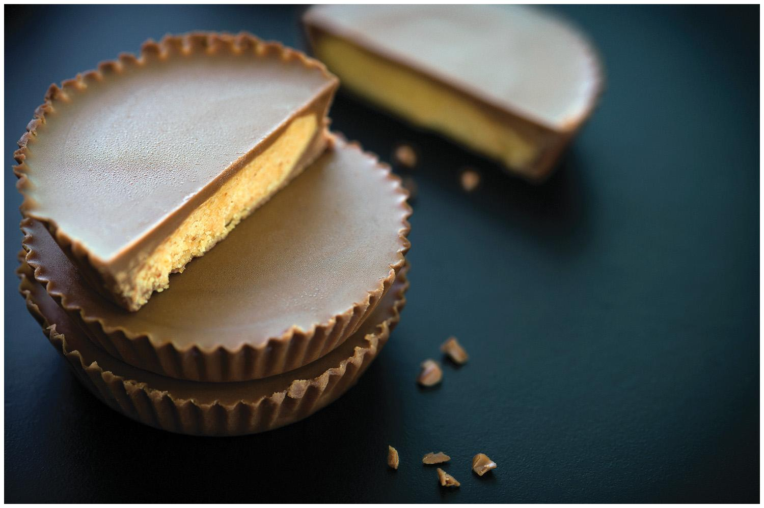

Determinants of the Price Elasticity of Demand—2
Share of the budget spent on the good:
Determines how much the price change affects the consumer.
  “Big-ticket items” -> elastic demand
  Inexpensive items -> inelastic demand
Notes:
Lecture tip:
Ask students which of the following events they would react to more:
20 percent sale on a new vehicle you want
20 percent sale on candy bar
The key point to make here is how big the effect will be of a given price change on the person’s life.
[car lot: Jeffry W. Myers/Getty Images; candy: supparsorn/Shutterstock]

Slide 15
Determinants of the Price Elasticity of Demand—3
Necessities versus luxuries:
Affects the options the consumer faces.
  Luxuries -> elastic demand (ex. Cruises)
  Necessities -> inelastic demand (ex. Insulin)
Notes:
Lecture notes:
When the price of a good rises, the consumer will typically want to buy less.
Ask students to suggest some “necessities” in their lives.
Some possible “necessities” include:
electricity
Internet
gasoline
mobile phone service
clean water
medication
toilet paper
Now, ask them to list true luxuries.
Some possible luxuries include:
vacations
dining out
jewelry
designer clothes
imported beers
Follow up by asking them to consider how they would respond to a 10 percent change in the price of each.
For which goods will they alter their purchases by the largest amount?

Slide 16
Determinants of the Price Elasticity of Demand—4
4. Time and adjustment process: Affects the ability of consumers to respond to changes in prices.
  Long time horizon -> elastic demand
  Short time horizon -> inelastic demand
Notes:
Lecture tip:
Point out that there are three time periods of interest:
Immediate run:
No time to adjust behavior.
Perfectly inelastic.
Short run:
Consumers can partially adjust their behavior.
Long run:
Consumers can fully adjust to market conditions.
Over time, consumers are:
more able to find substitutes
more able to adjust for price changes in other ways
consuming less of the good.
You can provide some examples of this, such as gas consumers shifting to more fuel-efficient cars, or using public transportation.
A good example of when there is little time to make a decision is a medical emergency.
Suggested video clip: The Simpsons, “I Love Lisa” (see Tip #147).
Homer forgets until the last minute to buy Marge a Valentine’s Day gift, so he ends up paying $100 for a box of chocolates.
Classroom activity: Think-Pair-Share: Examples of Demand Elasticity (see Tip #162).
This is a useful activity for reviewing all of the factors that affect the price elasticity of demand.

Slide 17
The Determinants of Price Elasticity:
A Summary
The price elasticity of demand depends on:
  the extent to which close substitutes are available
  The share of the budget spent on the good
  whether the good is a necessity or a luxury
  the time horizon—elasticity is higher in the long run than the short run
Notes:
‹#›
This slide is a convenience for your students, and replicates a similar table from the text.
If you’re pressed for time, it is probably safe to omit this slide from your presentation.

Slide 18



Do not edit
How to change the design
Rank from least elastic (insensitive to price changes) to most elastic (sensitive to price changes)
Presenting with animations, GIFs or speaker notes? Enable our Chrome extension
Notes:
📣 This is Slido interaction slide, please don't delete it.
✅ Click on 'Present with Slido' and the poll will launch automatically when you get to this slide.

Slide 19
A few elasticities from the real world
Healthcare | - 0.2
Rice | - 0.5
Beef | - 1.6
Restaurant meals | - 2.3
Mountain Dew | - 4.4
Notes:
This slide corresponds to an FYI box in the textbook. The estimates are from various studies; see the textbook for more information.

Slide 20
The Variety of Demand Curves
The price elasticity of demand is closely related to the slope of the demand curve.
Rule of thumb:
The flatter the curve, the bigger the elasticity.
The steeper the curve, the smaller the elasticity.
Notes:
‹#›
Economists classify demand curves according to their elasticity.
The next five slides present the five different classifications, from least to most elastic.

Slide 21
“Perfectly inelastic demand” (one extreme case)
Price elasticity
of demand
% change in Q
0%
=
=
= 0
% change in P
10%
D curve:
P
D
vertical
P₁
Consumers’
price sensitivity:
P₂
none
P falls by 10%
Q
Elasticity:
Q₁
0
Q changes
by 0%
Notes:
‹#›
If Q doesn’t change, then the percentage change in Q equals zero, and thus elasticity equals zero.
It is hard to think of a good for which the price elasticity of demand is literally zero. Take insulin, for example. A sufficiently large price increase would probably reduce demand for insulin a little, particularly among people with very low incomes and no health insurance.
However, if elasticity is very close to zero, then the demand curve is almost vertical. In such cases, the convenience of modeling demand as perfectly inelastic probably outweighs the cost of being slightly inaccurate.

Slide 22
“Inelastic demand”
Price elasticity
of demand
% change in Q
< 10%
=
=
< 1
% change in P
10%
D curve:
P
relatively steep
Consumers’
price sensitivity:
P₁
P₂
relatively low
D
P falls by 10%
Q
Elasticity:
Q₂
Q₁
< 1
Q rises less than 10%
Notes:
‹#›
An example: Student demand for textbooks that their professors have required for their courses.
Here, it’s a little more clear that elasticity would be small, but not zero. At a high enough price, some students will not buy their books, but instead will share with a friend, or try to find them in the library, or just take copious notes in class.
Another example: Gasoline in the short run.

Slide 23
“Unit elastic demand”
Price elasticity
of demand
% change in Q
10%
=
=
= 1
% change in P
10%
D curve:
P
intermediate slope
P₁
Consumers’
price sensitivity:
P₂
intermediate
D
P falls by 10%
Q
Elasticity:
Q₁
Q₂
1
Q rises by 10%
Notes:
‹#›
This is the intermediate case: the demand curve is neither relatively steep nor relatively flat. Buyers are neither relatively price-sensitive nor relatively insensitive to price.
(This is also the case where price changes have no effect on revenue.)

Slide 24
“Elastic demand”
Price elasticity
of demand
% change in Q
> 10%
=
=
> 1
% change in P
10%
D curve:
P
relatively flat
P₁
Consumers’
price sensitivity:
P₂
D
relatively high
P falls by 10%
Q
Elasticity:
Q₁
Q₂
> 1
Q rises more than 10%
Notes:
‹#›
A good example here would be breakfast cereal, or nearly anything with readily available substitutes.
An elastic demand curve is flatter than a unit elastic demand curve (which itself is flatter than an inelastic demand curve).

Slide 25
“Perfectly elastic demand” (the other extreme)
Price elasticity
of demand
% change in Q
any %
=
=
= infinity
% change in P
0%
D curve:
P
horizontal
P₂ =
P₁
D
Consumers’
price sensitivity:
extreme
P changes by 0%
Q
Elasticity:
Q₁
Q₂
infinity
Q changes
by any %
Notes:
‹#›
“Extreme price sensitivity” means the tiniest price increase causes demand to fall to zero.
“Q changes by any %” – when the D curve is horizontal, quantity cannot be determined from price. Consumers might demand Q1 units one month, Q2 units another month, and some other quantity later. Q can change by any amount, but P always “changes by 0%” (i.e., it doesn’t change).
If perfectly inelastic is one extreme, this case (perfectly elastic) is the other.
Here’s a good real-world example of a perfectly elastic demand curve, which foreshadows an upcoming chapter on firms in competitive markets. Suppose you run a small family farm in Iowa. Your main crop is wheat. The market demand curve in this market is downward-sloping, and the market demand and supply curves determine the price of wheat. Suppose that price is $5/bushel.
Now consider the demand curve facing you, the individual wheat farmer. If you charge a price of $5, you can sell as much or as little as you want. If you charge a price even just a little higher than $5, demand for YOUR wheat will fall to zero: Buyers would not be willing to pay you more than $5 when they could get the same wheat elsewhere for $5. Similarly, if you drop your price below $5, then demand for YOUR wheat will become enormous (not literally infinite, but “almost infinite”): if other wheat farmers are charging $5 and you charge less, then EVERY buyer will want to buy wheat from you.
Why is the demand curve facing an individual producer perfectly elastic? Recall that elasticity is greater when lots of close substitutes are available. In this case, you are selling a product that has many perfect substitutes: the wheat sold by every other farmer is a perfect substitute for the wheat you sell.

Slide 26
Elasticity
Inelastic → Price Changes > Quantity Changes
Elastic → Quantity changes > Price Changes

Slide 27

Elasticity and Revenue
Who made more?

Slide 28
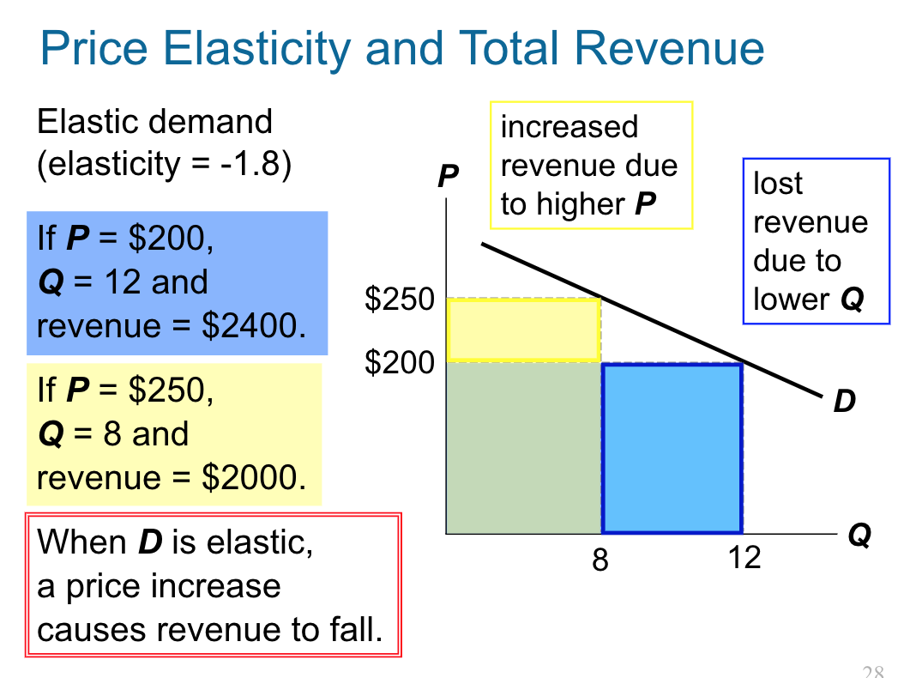

Slide 29
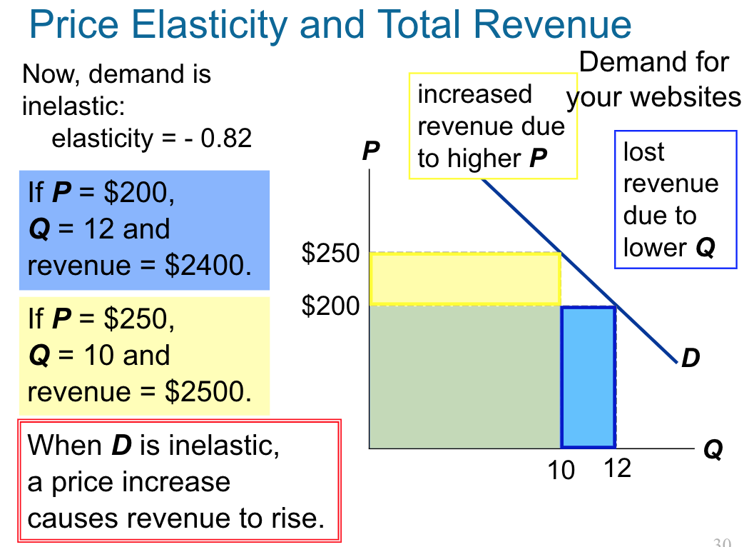

Slide 30
Elasticity
Inelastic → Price Changes > Quantity Changes → Price and Revenue move together
Elastic → Quantity changes > Price Changes → Quantity and Revenue move together

Slide 31
Elasticity and Revenue
Who made more?

Slide 32
Elasticity and Revenue
Luis – $99 price — $45320 in revenue
Daniel — $500 price — $15000 in revenue
https://youtu.be/cXeKInV_SCg?si=w1eHtLtQdgb_0Z-b

Slide 34

Do not edit
How to change the design
What costs too much?
Presenting with animations, GIFs or speaker notes? Enable our Chrome extension
Notes:
📣 This is Slido interaction slide, please don't delete it.
✅ Click on 'Present with Slido' and the poll will launch automatically when you get to this slide.

Slide 35
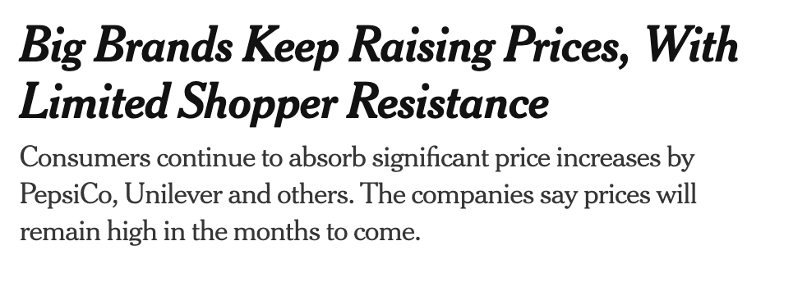


Short Run vs. Long Run

Slide 36
Elasticity Practice
You are advising a skateboard company. Elasticity of demand for their product is -3. Should they increase or decrease prices to raise revenue?
The government wants to decrease drinking by 20%. Elasticity of demand is -.5. Price of whisky is $20. What should the government force the price up to?

Slide 37
Formula (Elasticity at a point on the Demand Curve)
E_{Q,p}=(dQ/dP)(P/Q)
Example
Q=200-10P
Elasticity at P=10, Q=100
E=(-10)(10/100)=-1

Slide 38
Price Elasticity of Supply
Price elasticity of supply
Percentage change in Q^{s}
=
Percentage change in P
Price elasticity of supply measures how much Q^{s} responds to a change in P.
Loosely speaking, it measures sellers’
price-sensitivity.
Notes:
‹#›
Most everything in the “price elasticity of supply” section corresponds to analogous concepts from the “price elasticity of demand” section. So, it is probably safe to move through this section more quickly.

Slide 39
Price Elasticity of Supply
Price elasticity of supply
Percentage change in Q^{s}
=
Percentage change in P
P
Example:
S
P rises by 8%
P₂
Price
elasticity
of supply equals
P₁
16%
= 2.0
Q rises by 16%
Q
8%
Q₁
Q₂
Notes:
‹#›

Slide 40
The Variety of Supply Curves
The slope of the supply curve is closely related to price elasticity of supply.
Rule of thumb:
The flatter the curve, the bigger the elasticity.
The steeper the curve, the smaller the elasticity.
Five different classifications…
Notes:
‹#›
Economists classify supply curves according to their elasticity.
The next five slides present the different classifications, from least to most elastic.

Slide 41
“Perfectly inelastic” (one extreme)
Price elasticity
of supply
% change in Q
0%
=
=
= 0
% change in P
10%
S curve:
P
S
vertical
P₂
Sellers’
price sensitivity:
P₁
none
P rises by 10%
Q
Elasticity:
Q₁
0
Q changes
by 0%
Notes:
‹#›

Slide 42
“Inelastic”
Price elasticity
of supply
% change in Q
< 10%
=
=
< 1
% change in P
10%
S curve:
P
relatively steep
S
P₂
Sellers’
price sensitivity:
P rises by 10%
P₁
relatively low
Q
Elasticity:
Q₁
Q₂
< 1
Q rises less than 10%
Notes:
‹#›

Slide 43
“Unit elastic”
Price elasticity
of supply
% change in Q
10%
=
=
= 1
% change in P
10%
S curve:
P
intermediate slope
S
P₂
Sellers’
price sensitivity:
P₁
intermediate
P rises by 10%
Q
Elasticity:
Q₁
Q₂
= 1
Q rises
by 10%
Notes:
‹#›

Slide 44
“Elastic”
Price elasticity
of supply
% change in Q
> 10%
=
=
> 1
% change in P
10%
P
S
S curve:
relatively flat
P₂
Sellers’
price sensitivity:
P rises by 10%
P₁
relatively high
Q
Elasticity:
Q₁
Q₂
> 1
Q rises more than 10%
Notes:
‹#›

Slide 45
“Perfectly elastic” (the other extreme)
Price elasticity
of supply
% change in Q
any %
=
=
= infinity
% change in P
0%
S curve:
P
horizontal
P₂ =
P₁
S
Sellers’ price sensitivity:
extreme
P changes by 0%
Q
Elasticity:
Q₁
Q₂
infinity
Q changes
by any %
Notes:
‹#›

Slide 46
The Determinants of Supply Elasticity
The more easily sellers can change the quantity they produce, the greater the price elasticity of supply.
  Example: Supply of beachfront property is harder to vary and thus less elastic than supply of new cars.
For many goods, price elasticity of supply
is greater in the long run than in the short run,
because firms can build new factories,
or new firms may be able to enter the market.
Notes:
‹#›
This section is not perfectly analogous to the section on the determinants of the price elasticity of demand, but it’s similar enough that you can probably cover it more quickly and with much less hand-holding.

Slide 47
Problem–
The supply of LA property is inelastic. The supply of AZ property is elastic.
Suppose population growth causes
demand for both goods to double
(at each price, Q^{d} doubles).
For which product will P change the most?
For which product will Q change the most?
Notes:
‹#›
This section is not perfectly analogous to the section on the determinants of the price elasticity of demand, but it’s similar enough that you can probably cover it more quickly and with much less hand-holding.

Slide 48
Problem–
LA housing (inelastic supply):
When supply
is inelastic,
an increase in demand has a bigger impact on price than on quantity.
P
D₂
D₁
S
P₂
B
P₁
A
Q
Q₁
Q₂
Notes:
‹#›
This section is not perfectly analogous to the section on the determinants of the price elasticity of demand, but it’s similar enough that you can probably cover it more quickly and with much less hand-holding.

Slide 49
Problem–
Phoenix Housing
(elastic supply):
When supply
is elastic,
an increase in demand has a bigger impact on quantity than on price.
P
D₁
D₂
S
P₂
B
A
P₁
Q
Q₁
Q₂
Notes:
‹#›
This section is not perfectly analogous to the section on the determinants of the price elasticity of demand, but it’s similar enough that you can probably cover it more quickly and with much less hand-holding.

Slide 50
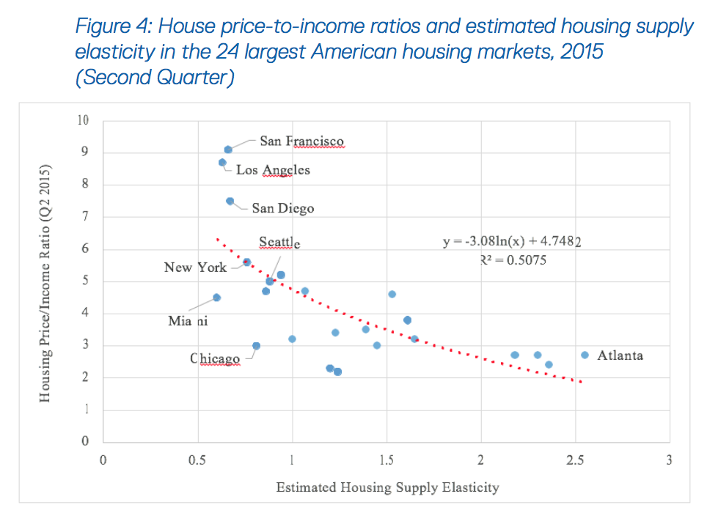
Source: Gordon (2017)
Notes:
‹#›
This graph replicates the one in Figure 6. Note: The graph here is not quite drawn to scale.
When the price rises from $3 to $4 (a 29% increase, using the midpoint method), quantity rises from 100 to 120 (or 67%). Because 67% > 29%, price elasticity of supply is greater than one. When the price rises from $12 to $15 (22%), quantity rises from 500 to 525 (about 5%), so price elasticity of supply is less than one.
The way I like to explain this is as follows:
When output is very low, it is relatively easy for firms to increase output. They may have excess capacity, or they are not requiring full effort from their workers. Increasing output is not difficult, so it doesn’t take much of an increase in price to induce an increase in production.
When output is very high, it is relatively expensive for firms to increase output further: there’s little or no excess capacity, they are already running their factories and machines at a high level of intensity. To increase output further, they might have to pay their workers overtime, and their machines experience more wear and tear and therefore require more repairs. So, at high levels of output, it takes a much larger price increase to make firms willing to increase output further.
Eventually, firms bump up against their capacity constraints, and simply cannot increase output in response to further price increases.
Of course, all of this applies to the short run. In the long run, firms can build more factories, and (depending on the market structure) new firms can enter the market.
Real-world example: In the peak summer driving season, gasoline demand is highest. Many refineries are producing near capacity, so the supply curve is steep. In other months, when demand is lower, refineries have more excess capacity, and the supply curve is not as steep.

Slide 51
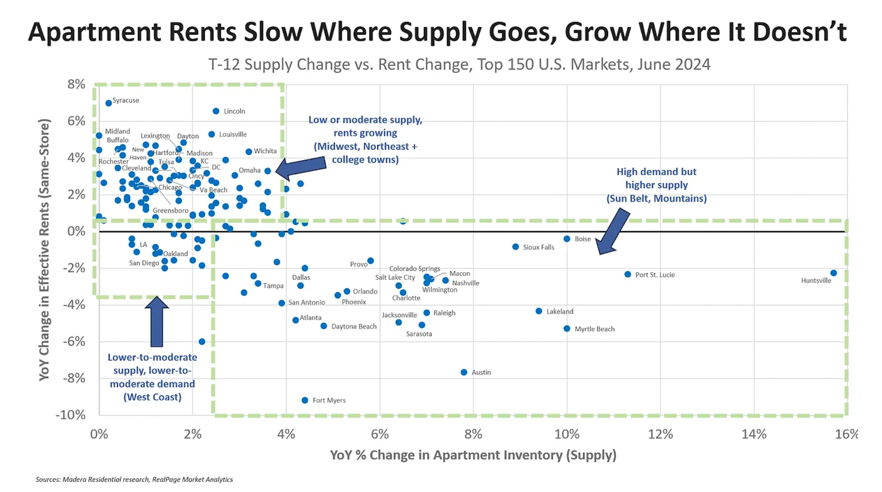

Slide 52
Name a problem facing society

Slide 53
Inelastic Housing Supply
Zoning (75% of LA is zoned for single family housing)
Environmental Laws (mostly used to block housing for non-environmental reasons)
Difficult Permitting Process
Historic Site designations

Slide 54
Inelastic Housing Supply Effects
Lower productivity. Moretti and Hsieh estimate that the US is 30% (or more) poorer due to restricted housing
People have less kids than they would like
Inequality (people who own land receive massive rents due to restrictions on building)
Arbitrary wealth distributions (why should someone who bought a home in LA in 1970 see it’s value 10x while someone in St. Louis sees their home price fall (in real terms))
Obesity (Car based lifestyle)
Climate Change (dense housing better for the environment)

Slide 55
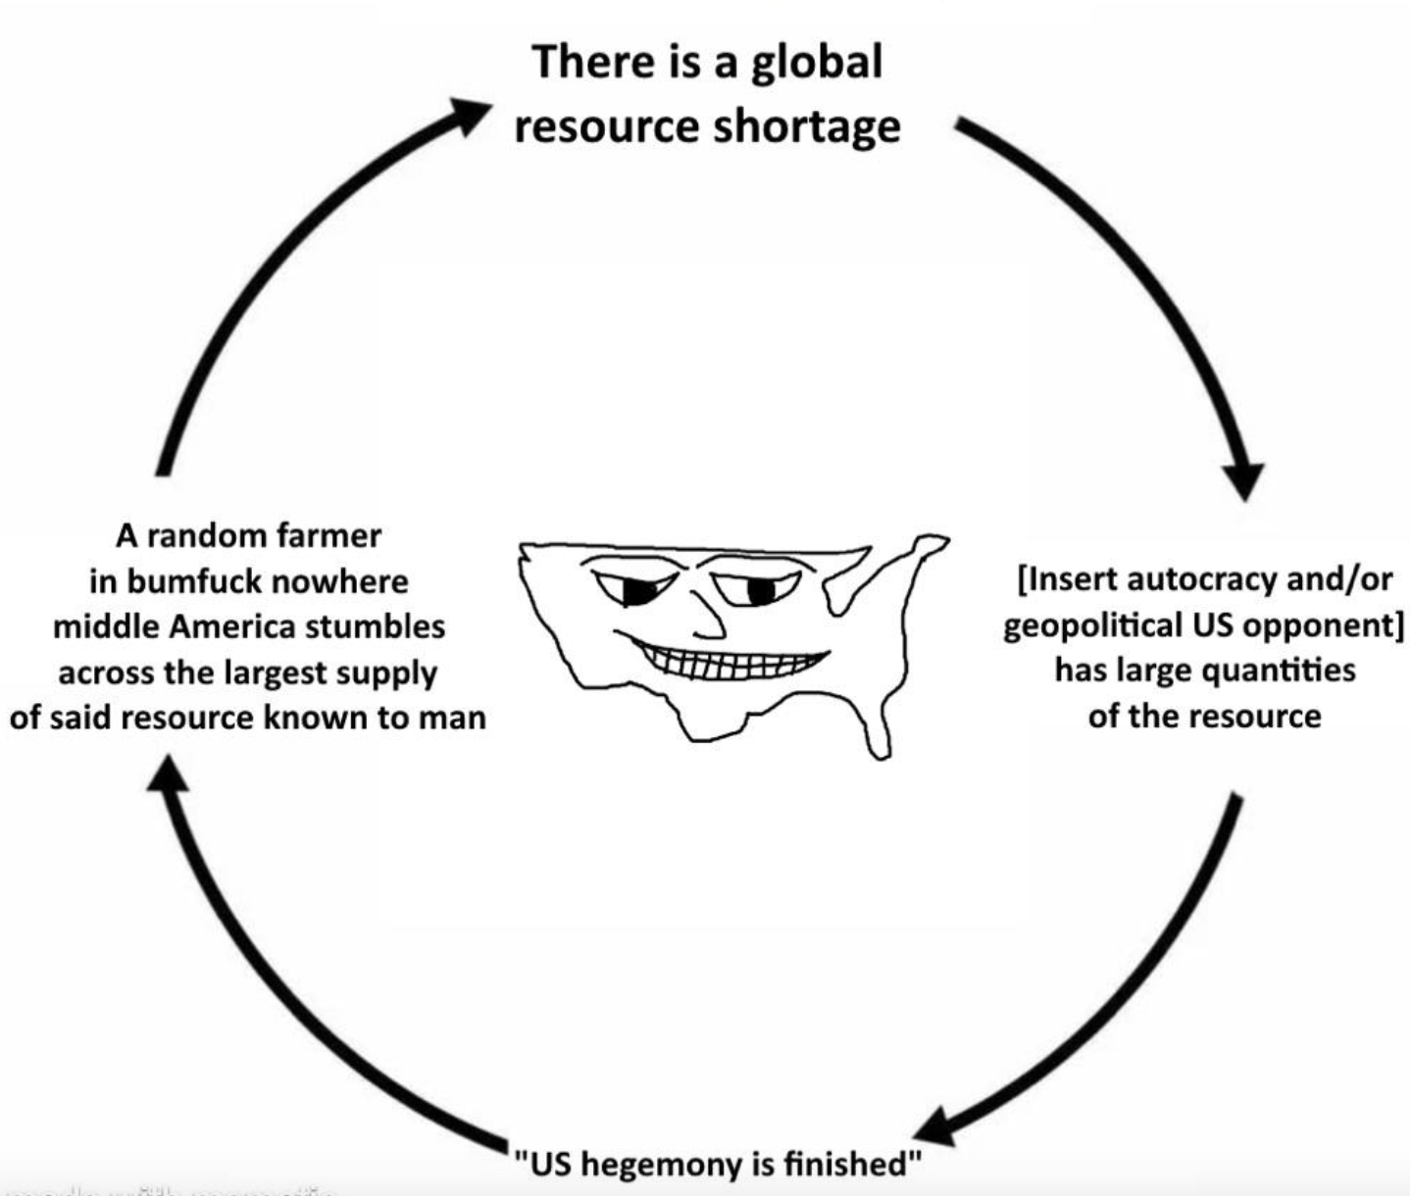
What does this meme have to do with the elasticity of supply?

Slide 56
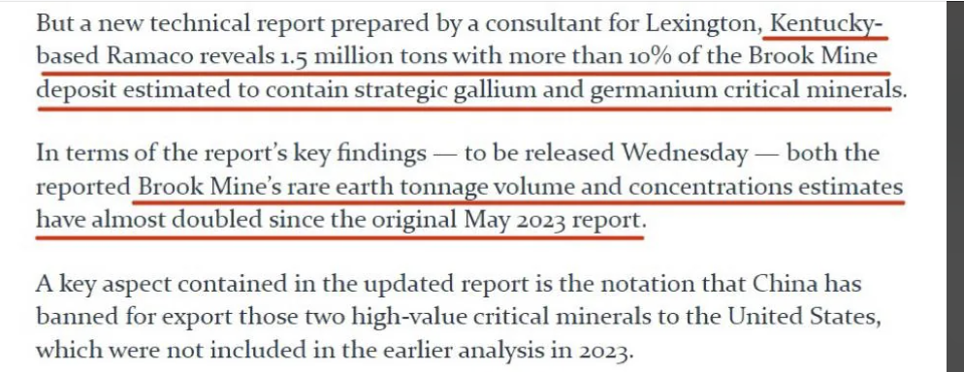



Slide 57
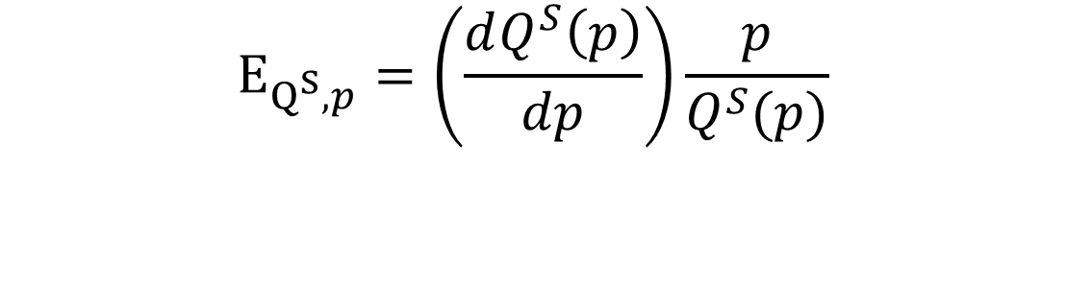
Elasticity of Supply
Price Elasticity of Supply (other formula)

